Slide 1
On the Implementation of a Secured Watermarking Mechanism Based on Cryptography and Bit Pairs Matching
Department of CSE Batch No: 13
Team Members :
217R1A0555 S.SAKETH RAJA REDDY
217R1A0531 KARNAM RAHUL
217R1A0529 KALLEM NITHIN REDDY
Under the Esteemed Guidance of: Dr.K.Maheswari

Slide 2
Table of Contents
Abstract
Existing Systems
Disadvantages
Proposed System
Advantages
Hardware and Software Requirements
Novelty of the Project
System Architecture
System modules
Use Case Diagram
Sequence Diagram
Class Diagram
Activity Diagram
Sample code
Results
Conclusion
Future Scope
References

Slide 3
Abstract
This is a novel image watermarking technique that combines LSB substitution with symmetric key cryptography to enhance digital data security. The technique works by organizing pixel bits of both the original image and an encrypted watermark into bit pairs, comparing them, and replacing matched pairs in the original image. If no match is found, the 0th bit pair is replaced with the watermark bits, and the two LSBs of the pixel are modified.
This method ensures:
High image quality: Achieves good PSNR values, maintaining imperceptibility.: Withstands attacks such as noise, filtering, and compression.
Efficient payload capacity: Optimizes the amount of hidden data.

Slide 4
Existing Watermarking Systems
LSB Substitution
Pixel Value Differencing (PVD)
Cryptography
LSB Matching

Slide 5
Challenges in Existing Watermarking Techniques
1
Imperceptibility
Maintaining the visual quality of the watermarked image is crucial. Some techniques can introduce noticeable distortions, impacting the overall quality.
2
Robustness
Watermarks should resist various attacks like noise addition, compression, filtering, and geometric distortions. Many existing methods struggle to maintain the watermark's integrity under these attacks.
3
Payload Capacity
The amount of watermark data that can be embedded in the cover image is critical. Some techniques are limited in their capacity, making it difficult to embed large or complex watermarks.

Slide 6
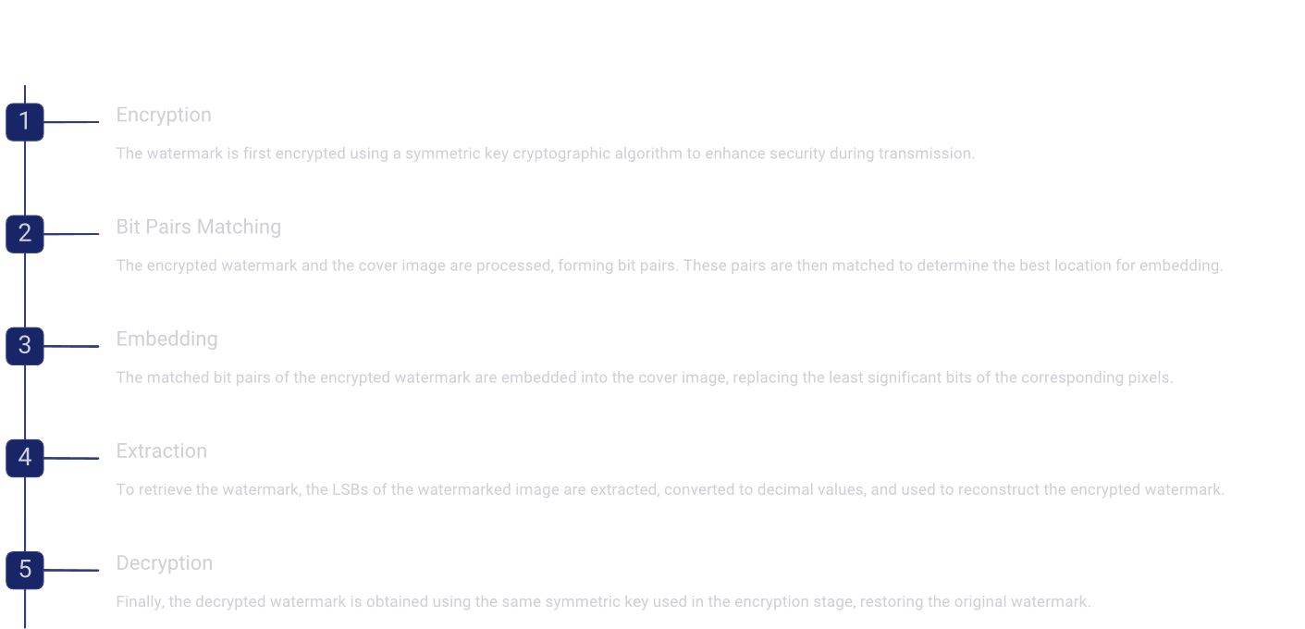

Slide 7
Advantages of the Proposed System
Enhanced Security
Improved Robustness
Increased Payload Capacity
Improved Imperceptibility

Slide 8
HARDWARE & SOFTWARE REQUIREMENTS:
HARD REQUIREMENTS :
Processor : Intel i5 or Ryzen 5
Hard Disk : 40 GB and Above
Monitor : 5 inches or Above
RAM : 4GB and Above
SOFTWARE REQUIREMENTS :
Operating system : Windows 11
Languages : Python 3.7.0
IDE : VS Code

Slide 9



Novelty and Impact
The proposed system introduces a novel approach to watermarking by combining cryptography with bit pairs matching, offering a unique and robust solution.
Stronger Encryption
The use of cryptography provides a higher level of security for the embedded watermark.
Increased Robustness
The bit pairs matching algorithm enhances the watermark's resilience against various attacks.
Unique Approach
The combination of cryptography and bit pairs matching offers a novel and effective solution.

Slide 10
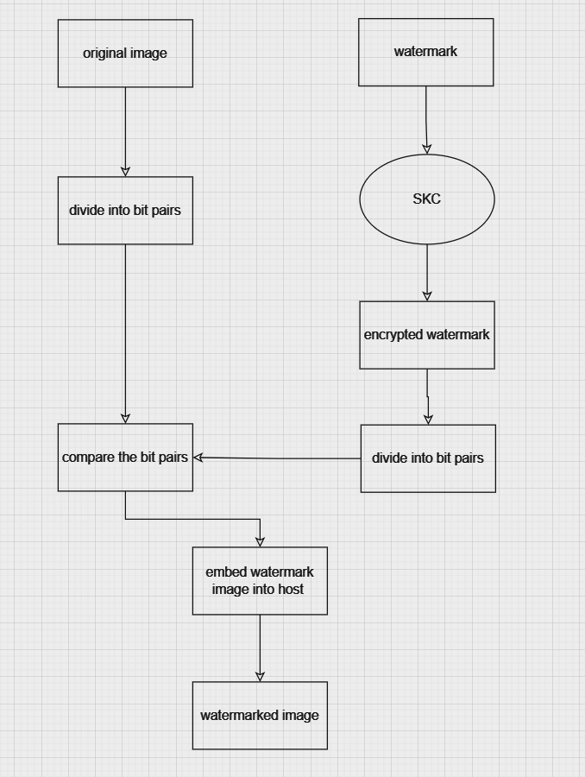
SYSTEM ARCHITECTURE
Embedding watermark using bit pairs matching

Slide 11
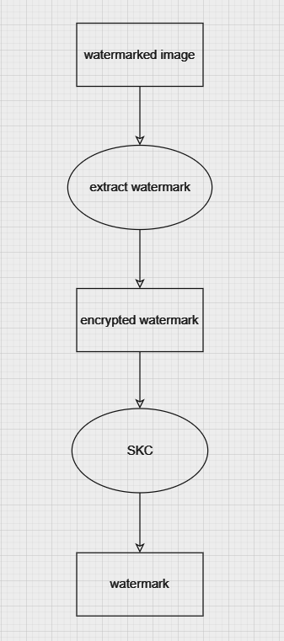
Extracting watermark from watermarked image

Slide 12
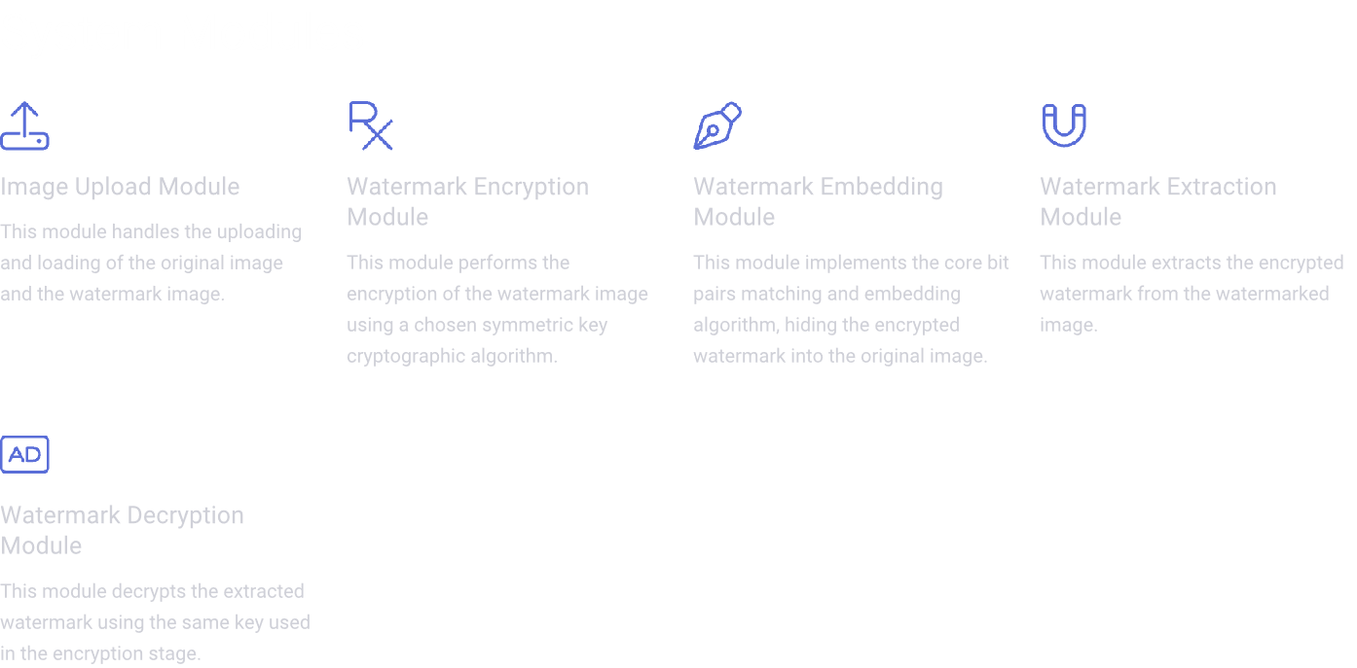

Slide 13
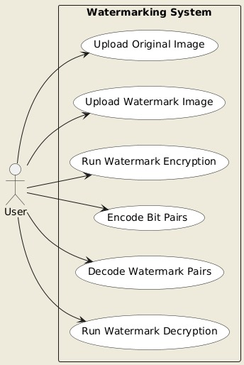
System Diagrams
Use Case Diagram

Slide 14
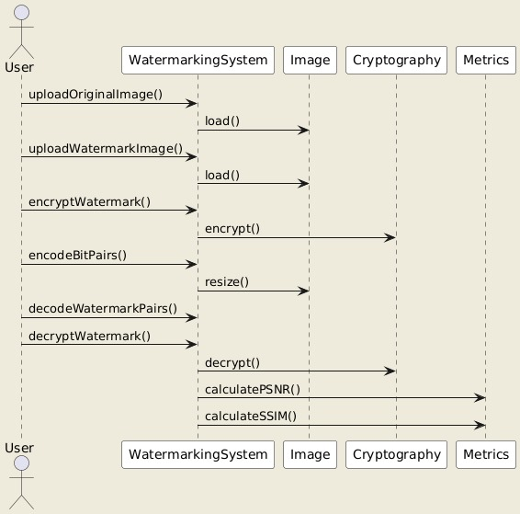
Sequence Diagram

Slide 15
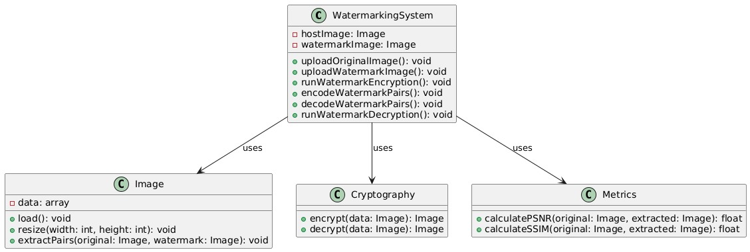
Class Diagram

Slide 16
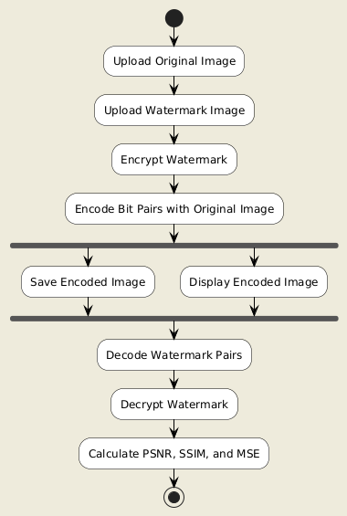
Activity Diagram

Slide 17
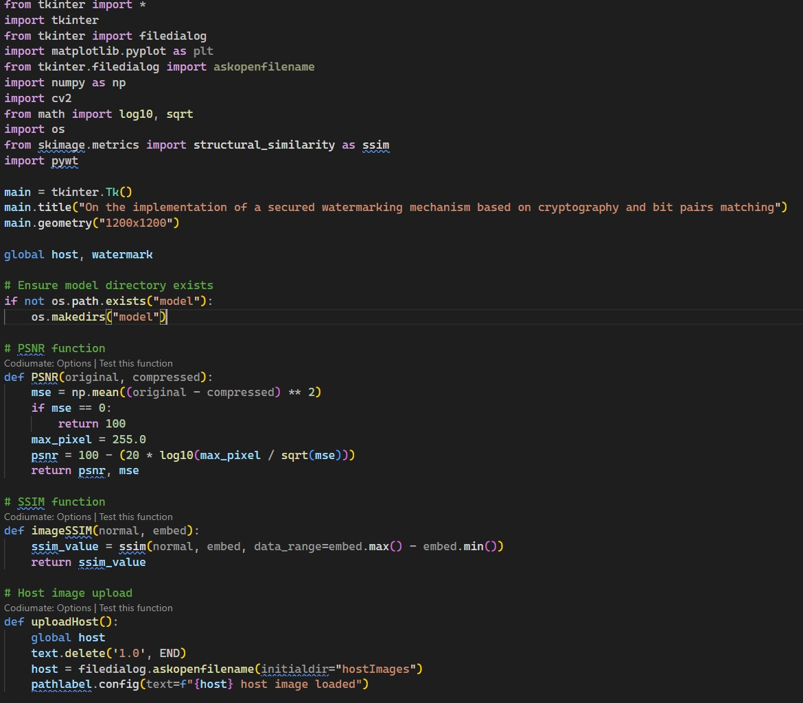
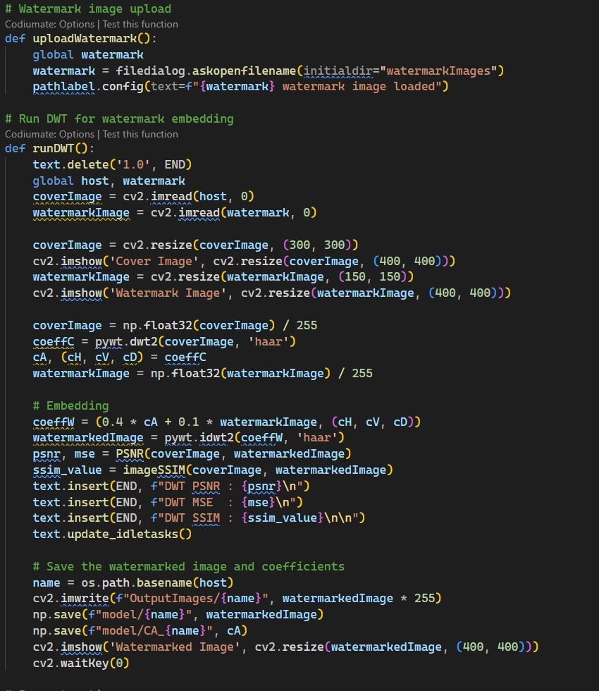
Sample code

Slide 18
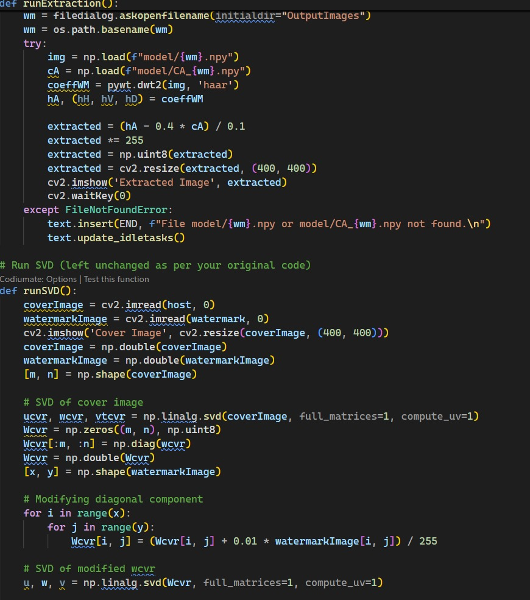
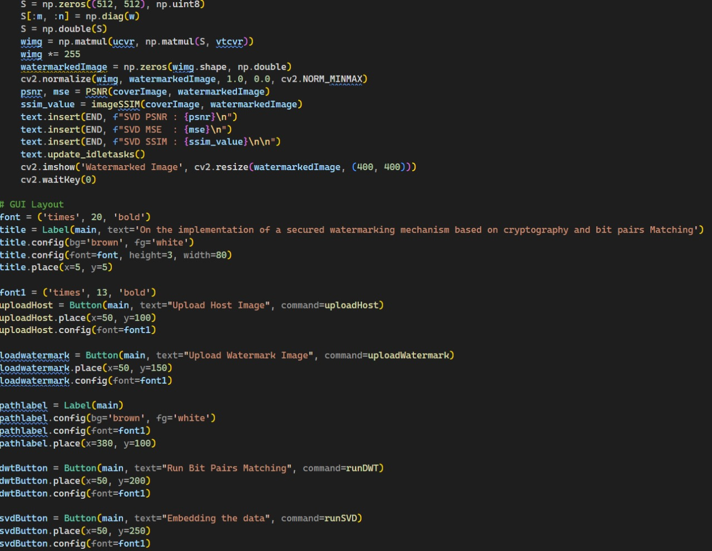

Slide 19
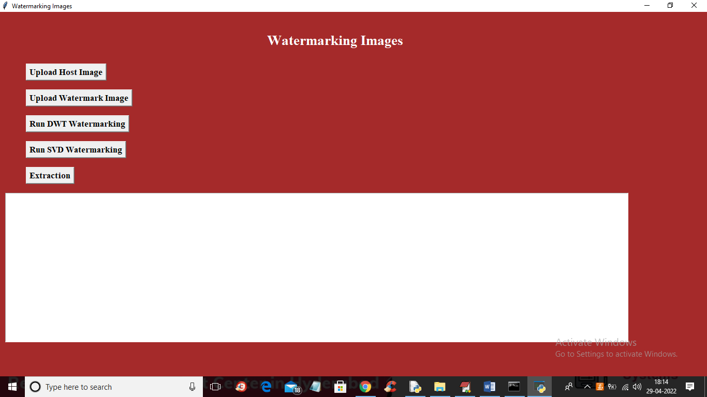
RESULTS

Slide 20
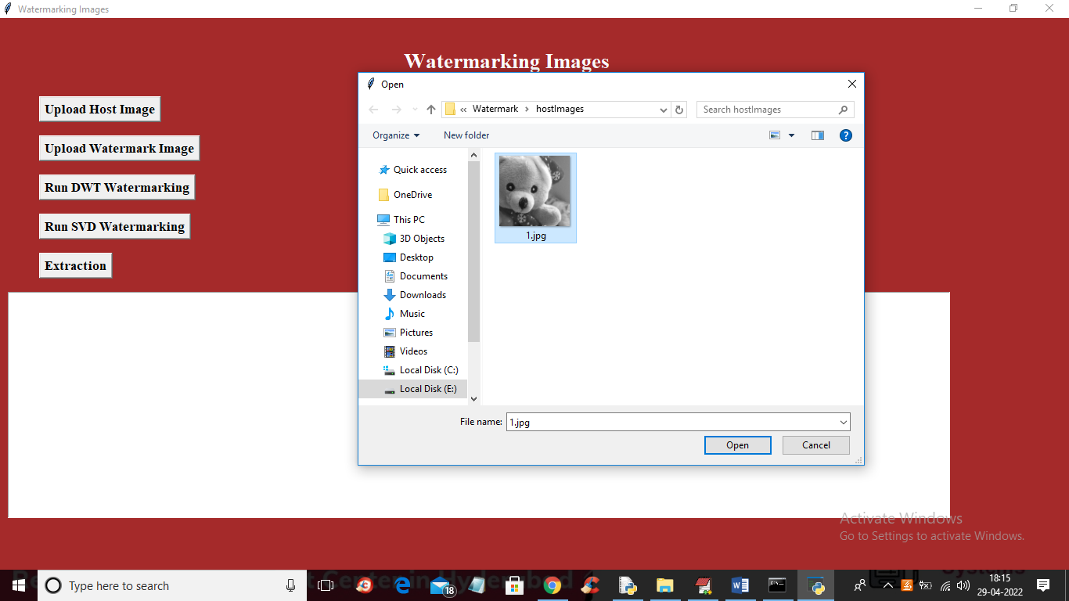

Slide 21


Slide 22


Slide 23


Slide 24
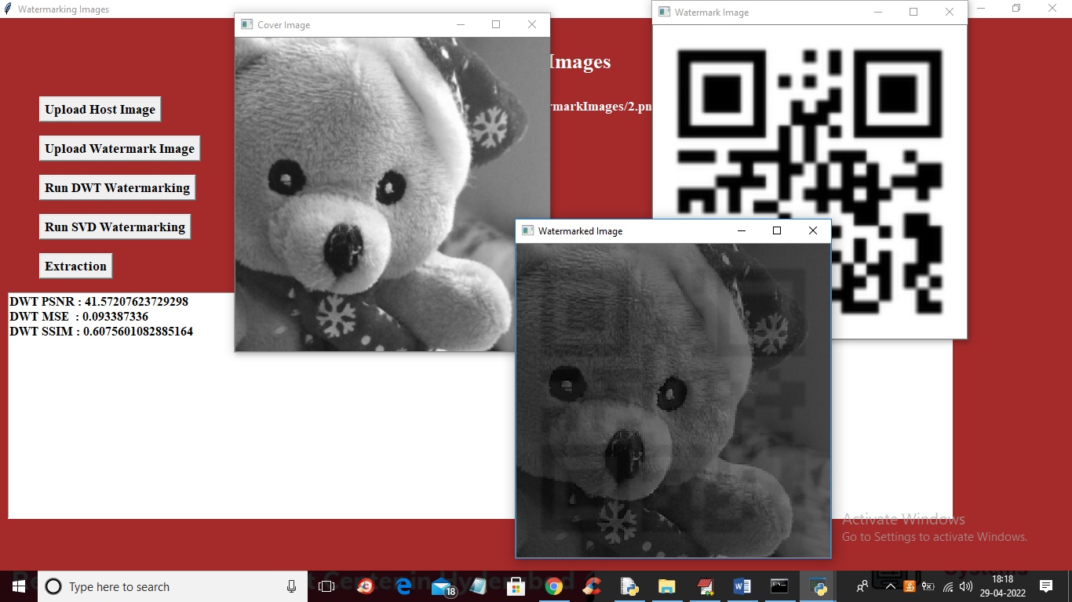

Slide 25
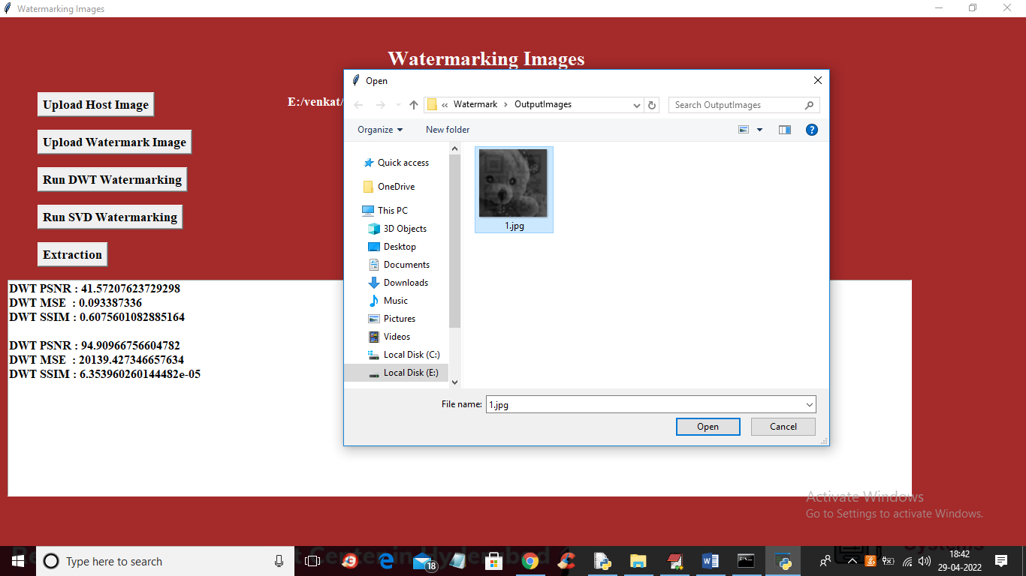

Slide 26
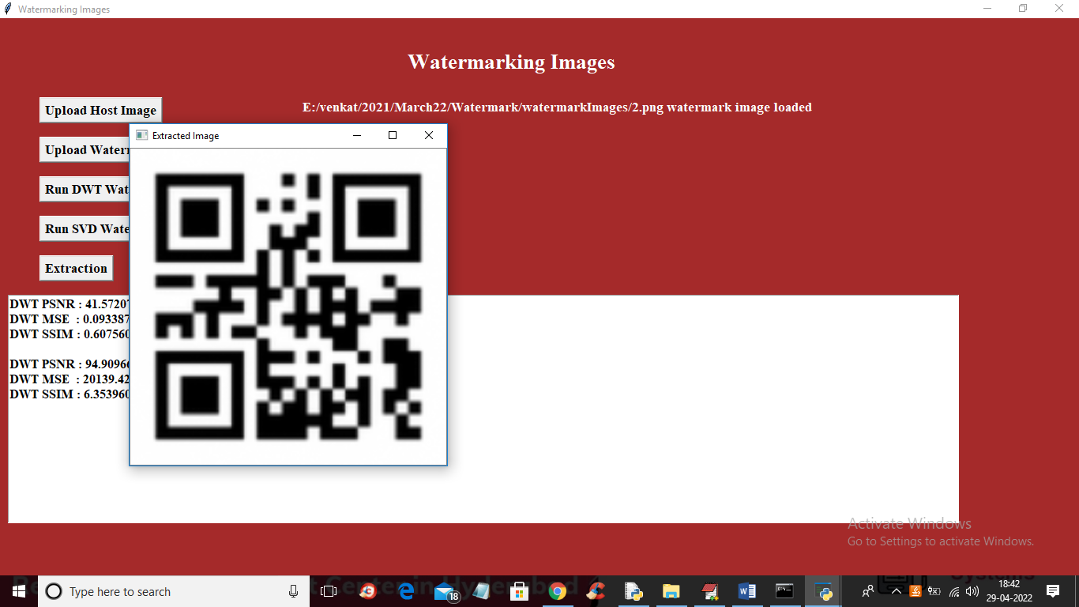

Slide 27
CONCLUSION
In this paper bit pairs similarity based LSB replacement watermarking mechanism is proposed. This mechanism is a new concept and which is different from all the previous mechanisms because its main focus is on bit pairs similarity. In this technique to make the watermark more secured, symmetric key cryptography is used and the data bits are arranged in pairs following the proposed scheme, which is different from all the existing techniques. The proposed technique is applied to 15 different grayscale test images. The proposed scheme is more secure, robust and higher payload based on good factors of imperceptibility proved from the results of the experiments we have done.

Slide 28
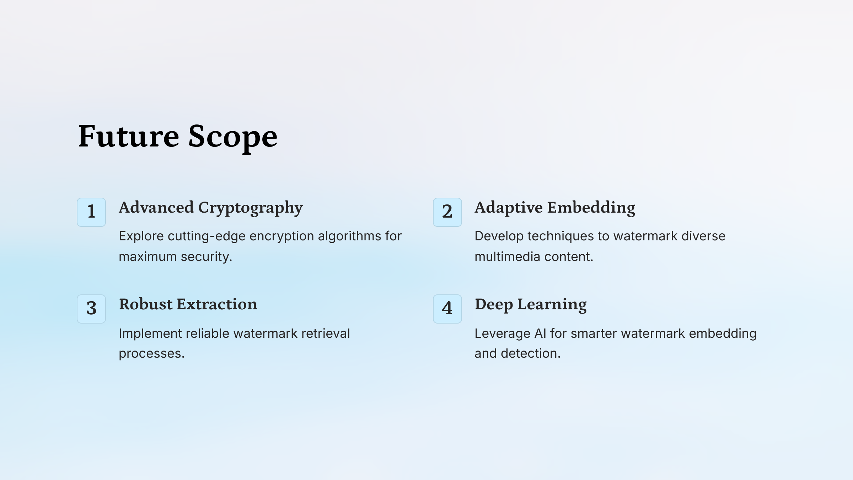

Slide 29
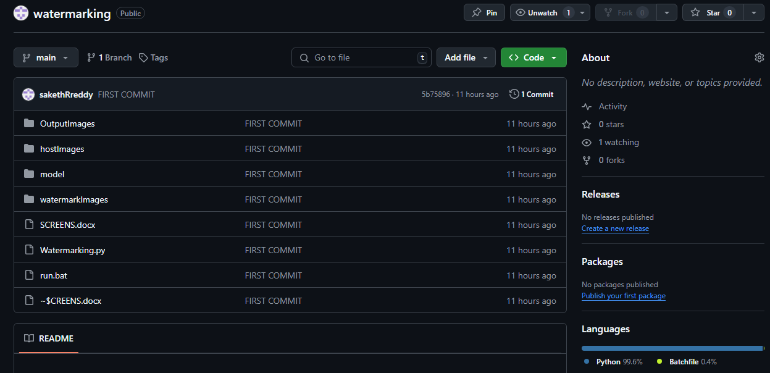
GITHUB LINK
https://github.com/sakethRreddy/watermarking

Slide 30
REFERENCES
1.Al-Otaibi, N.A., Gutub, A.A.A., 2014. Flexible stego-system for hiding text in images of personal computers based on user security priority. In: Proceedings of 2014 International Conference on Advanced Engineering Technologies (AET-2014), Dubai UAE, pp. 250–256.
2.Altaibi, N.A., Gutub, A.A., Khan, E.A., 2015. Stego-system for hiding text in images of personal computers. In: The 12th Learning and Technology Conference: Wearable Tech/Wearable Learning, Effat University, Jeddah, Kingdom of Saudi Arabia.
3.Gutab, A.A.A., Ghouti, L., 2007. Utilizing extension character ‘Kashida’ with pointed letters for arabic text digital watermarking. In: International Conference on Security and Cryptography (SECRYPT), Barcelona, Spain.
4.Gutub, A., Al-Qahtani, A., Tabakh, A., 2009. Triple-A: secure RGB image steganography based on randomization. In: The 7th ACS/IEEE International Conference on Computer Systems and Applications (AICCSA-2009), Rabat, Morocco, pp. 400–403
5.Hannigan, B.T., Reed, A., Bradley, B., 2001. Digital watermarking using improved human visual system model. In: Ping Wah Wong, Edward J. Delp (Eds.), Proc. SPIE. 4314, 468-474, Security and Watermarking of Multimedia Contents III.

